Slide 1
Using An-Najah htc cluster

Slide 2
What a htc?
HTC (High Throughput Computing) is a group of computers work in a unit to complete a specified task.

Slide 3
How to use that cluster?
You need username and password to enter to the cluster for registration please contact me at internal phone(رقم داخلي) 2823
Enter user/password at htclogin.najah.edu using ssh or ssh client like putty.

Slide 4
Submit a job to cluster
You can submit you code in some programming languages (JAVA,C/C++, python, perl) after testing it locally
You need to know some condor commands :
condor_submit, condor_q ,condor_status,condor_rm

Slide 5
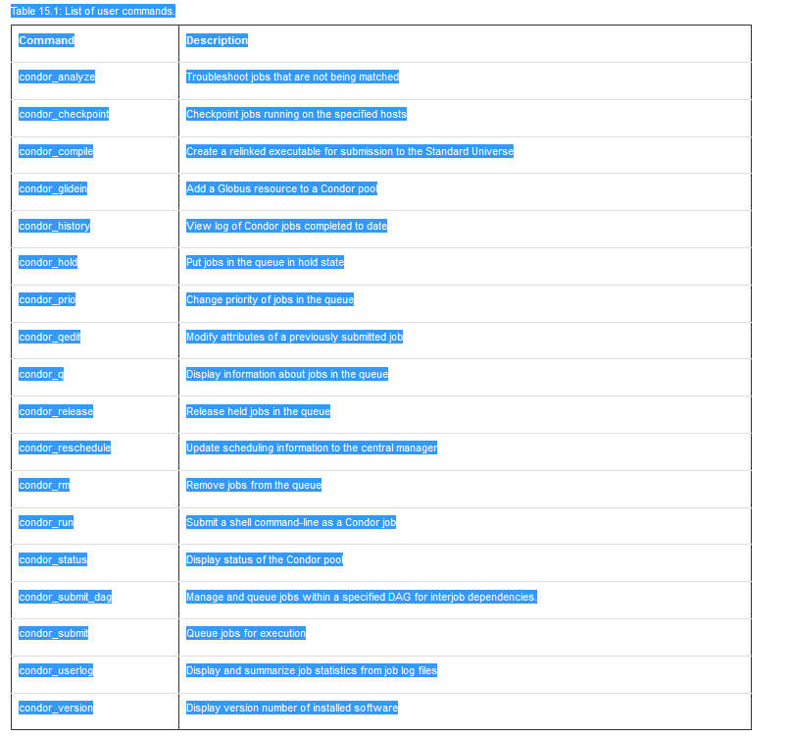

Slide 6
Login to the cluster
Download putty from the following link if you are using windows or just ssh if linux
Putty link
Then install it like any other program

Slide 7
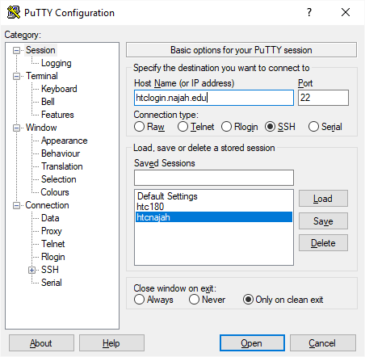
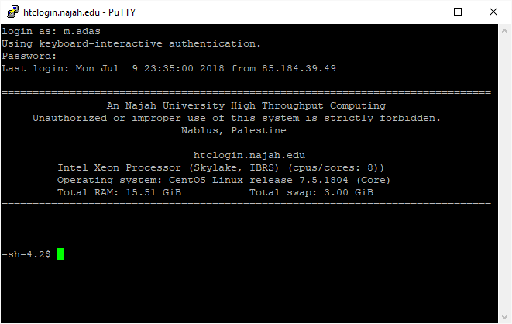
Use your username and password given to you

Slide 8
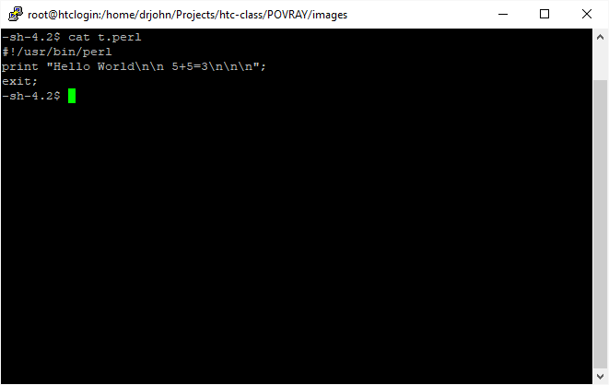
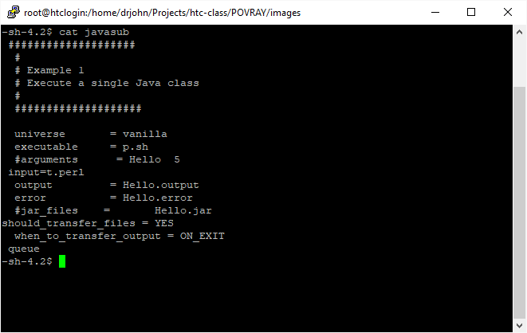
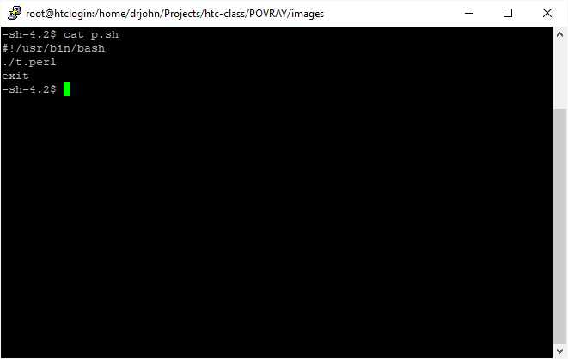
Example1—perl funny exmple
Notes:
Notes:
Should include script file in the submit file
The issue this command to submit
condor_submit submit_file
Then condor send the job to the queue and when there is free hosts to run the job execute it.
You can monitor you jobs by
condor_q
Remove any job by
condor_rm job_id
And review all jobs by
condor_history
Python the same steps

Slide 9
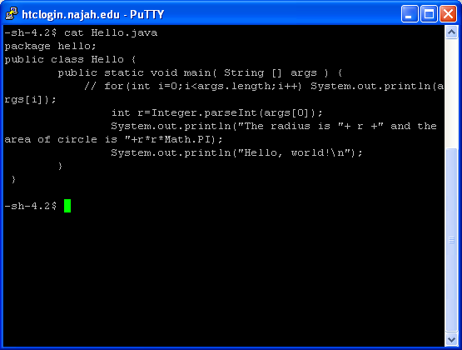
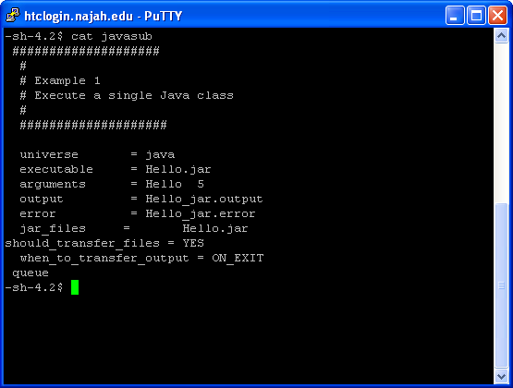
Java example
Notes:
Java example:
Note: please try to compile java on any host other than htclogin by ssh
Host are htc182…htc193
Compile : javac *.java
Jar (if more than one class) jar -cvf Hello.jar *.class

Slide 10
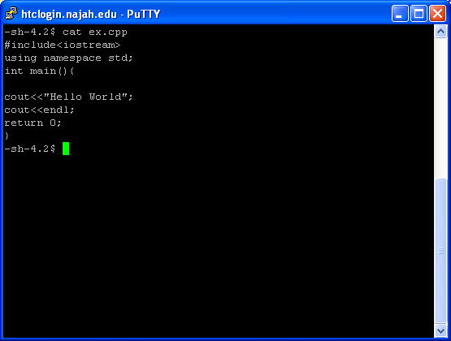
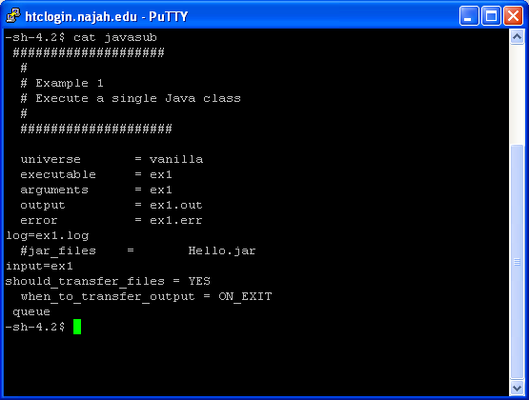
C/C++ Example
Notes:
Comple c/c++ code: g++ -o ex1 ex.cpp
To test before send to Condor:
./ex1
Then submit :condor_submit submit_file

Slide 11
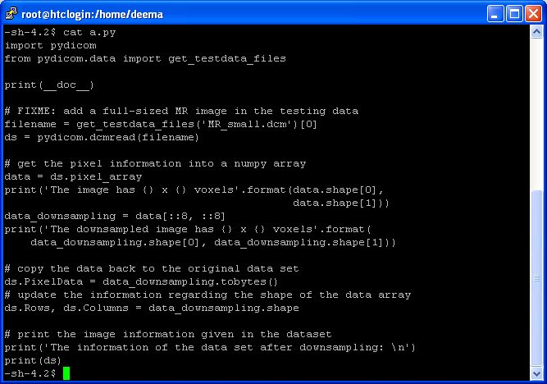
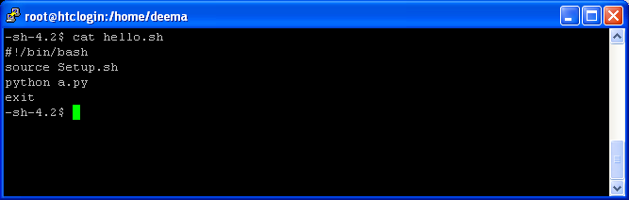
Anaconda example

Slide 12
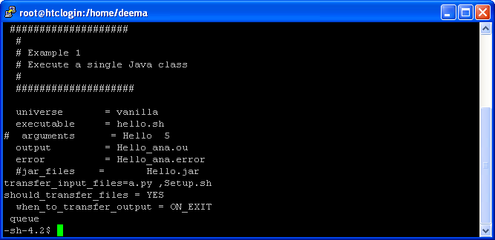
Cont. anaconda
Notes:
To use Anaconda in Condor you mush copy Setup.sh to every job folder and include in transfer_input_files alongside python code

